Slide 1



Night Match
Sponsored by
With Help from
Round Count: 150+
Stages by Eric Beerbaum, Marcel Englmaier, Stuart Wilson, & Jon Gieser

Slide 2
Specific Rules:
Standard Safety Rules apply. See USPSA rulebook
Specific amendment: You may detach guns while in holsters from your belt.
Chemlights must be worn on the belt at 180 degrees apart (front&back, left&right, etc. any way you turn we need to see them)
Scoring: Timeplus scoring. Neutralize targets as required in the WSB. 1 Alpha or 2 anywhere to neutralize unless otherwise specified.
Penalties for not doing what the WSB says will be decided by the Range Master. Squad input is encouraged. Maybe it’ll be something funny.
No Headlamps. We like our eyes. Surefire has donated lights you can blip to your jacket that will point down. Chest-level or lower if you have a handheld. Penalties for blinding folks will be funny and appropriate.

Slide 3
Stage 1, Bay 2: TBD
If you’d like to see something specific tested, let us know

Slide 4
Stage 2, Bay 3 Spock's Goatee Course Designer: Eric Beerbaum
Spock's Goatee is a 26 round unlimited course. There are 11 paper targets and 4 poppers. Paper must be neutralized and steel must fall to score. The start signal is audible.
The Handgun start position is standing in box A with wrists below belt. Handgun loaded and holstered. If you do not have a holster, the pistol will be loaded and placed on barrel 1. The PCC start position is standing in box A. PCC loaded, safety on, stock touching belt.
On the audible start signal, flip one of the randomized tiles on barrel 2. If the tile is black, brown paper and white steel are shoots and the rest are no-shoots. If the tile is white, white paper and red steel are shoots and the rest are no-shoots. Engage appropriate targets from within the shooting areas.

Slide 5
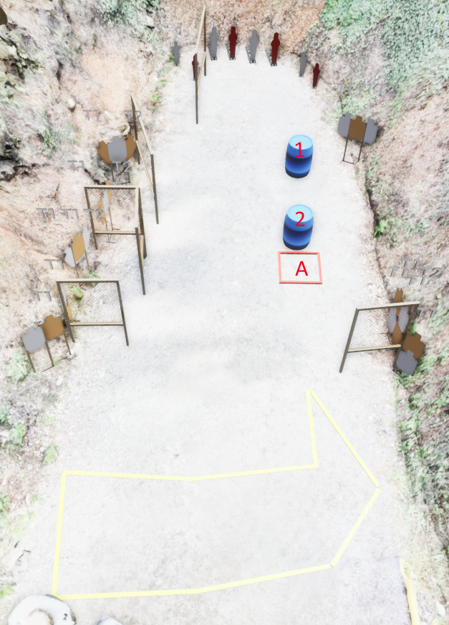
 | Stage 2, Bay 3 Spock's Goatee Course Designer: Eric Beerbaum

Slide 6
Stage 3, Bay 4 You Spin Me Right Round Course Designer: Marcel Englmaier
You Spin Me Right Round is at least a 14 round unlimited course. There are 2 square plates, 2 round plates, and a spinner. The square plates require 4 shots, the round plates 2 shots, and the spinner must be spun both ways. The start signal is audible.
The Handgun start position is standing with heels touching the start line and wrists below belt. Handgun loaded and holstered. If you do not have a holster, the pistol will be loaded and placed on barrel 1. The PCC start position is standing with heels touching the start line. PCC loaded, safety on, stock touching belt.
On the audible start signal, engage targets in the following order: First, spin the spinner while on the rooftop. Pelvis touching rooftop. Then engage the left square with at least 2 shots and the left round with at least 1 shot from the left box and the right square with at least 2 shots and the right round with at least 1 shot from the right box. Then spin the spinner the opposite way while on the rooftop. Pelvis touching rooftop. Finally, re-engage the left square with at least 2 shots and the left round with at least 1 shot from the left box and the right square with at least 2 shots and the right round with at least 1 shot from the right box.

Slide 7
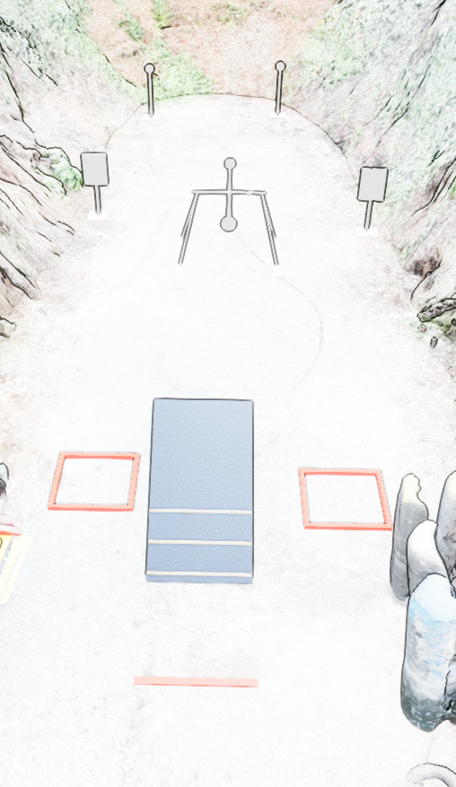

 | Stage 3, Bay 4 You Spin Me Right Round Course Designer: Marcel Englmaier

Slide 8
Stage 4, Bay 5: Sea of Steel
Design TBD but name should be obvious

Slide 9
Stage 5, Bay 6 Takeshi's Castle Course Designer: Eric Beerbaum
Takeshi’s Castle is a 40 round unlimited course. There are 10 paper targets and 20 poppers. Paper must be neutralized and steel must fall to score. The start signal is audible.
The Handgun start position is standing in box A with wrists below belt. Handgun loaded and holstered. If you do not have a holster, the pistol will be loaded and placed on barrel 1. The PCC start position is standing in box A. PCC loaded, safety on, stock touching belt.
On the audible start signal, engage targets from within the shooting areas.

Slide 10
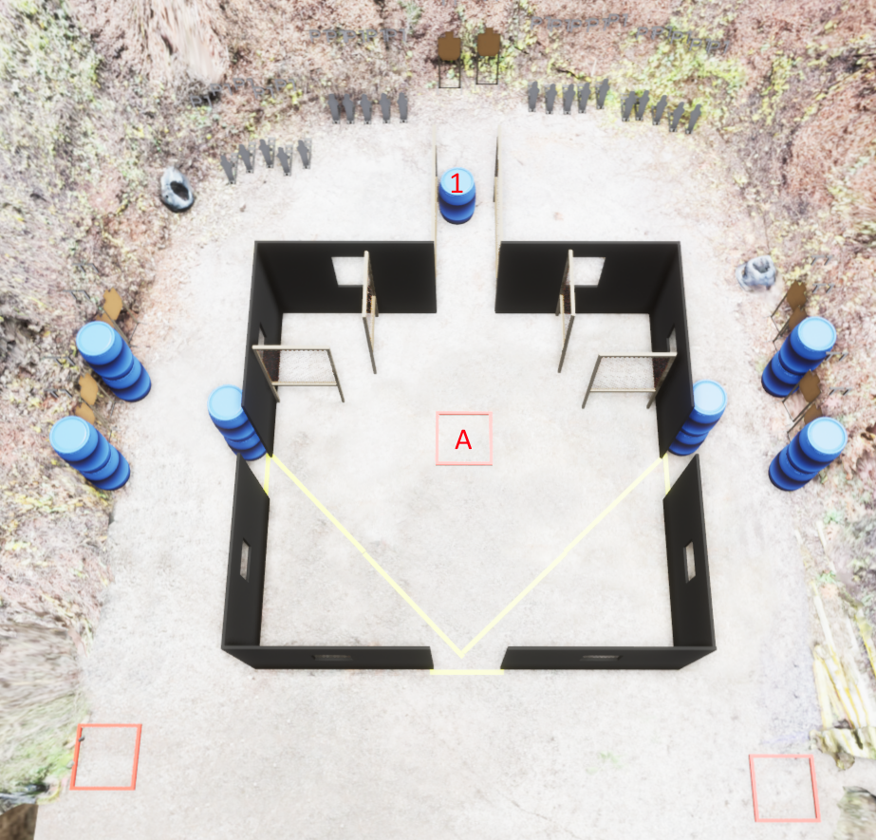
 | Stage 5, Bay 6 Takeshi's Castle Course Designer: Eric Beerbaum

Slide 11
Stage 6, Bay 7 Stu’s Night-Mare Course Designer: Stu Wilson
Stu’s Night-Mare is a 12 round unlimited course. There are 4 steel plates with light-flashers to indicate neutralized. The start signal is audible.
The Handgun start position is standing behind required fault line. Handgun loaded and holstered. If you do not have a holster, the pistol will be loaded and placed on barrel the corresponding barrel. The PCC start position is standing behind required fault line. PCC loaded, safety on, stock touching belt.
String 1: On the audible start signal, engage each target until flasher flashes from behind the 50yd line. String 2: On the audible start signal, engage each target until flasher flashes from behind the 40yd line. String 3: On the audible start signal, engage each target until flasher flashes from behind the 30yd line.

Slide 12
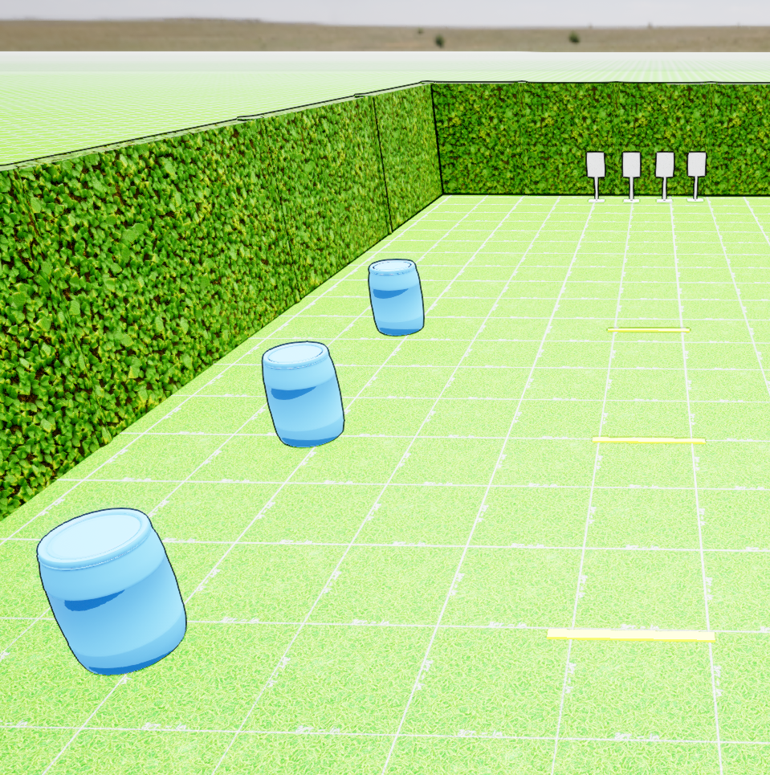
 | Stage 6, Bay 7 Stu’s Night-Mare Course Designer: Stu Wilson

